Slide 1

The COVID-19 Tracking Project (US)
By The Five Maskateers
Alanna Javier, Ali, Deniz, Anand Sharan, Donna Tigrett, and Elizabeth Koehler
Notes:
Motivation & Summary: - When assigned this project our group decided we wanted to analyze something related to Covid-19, as the pandemic has been going on for the majority of 2020. We decided to focus in on analyzing whether or not the socio-economic means of a geographic area had a relationship with the number of covid-19 cases in that area because there have been many reports that areas with less socio-economic means were affected more

Slide 2
Questions?
Objective This project researches the COVID 19 cases in the US and its correlation with US Economic data
What is the average confirmed COVID-19 cases per state in US? What are the five states with the MOST COVID-19 cases? What are the five states with the LEAST COVID-19 cases? Is there a correlation between top and bottom states COVID-19 cases and Per Capita Income? Is there a correlation between top and bottom states COVID-19 cases and population?

Slide 3
Where & How we found our data
COVID-19 data from New York times for year 2020
https://github.com/nytimes/covid-19-data
us_counties_nyt.csv
Census data - 5 yrs Census data for year 2017 https://www.census.gov/data/developers/data-sets/acs-5year.html
API is used to fetch economic and population data
Zip code to county data set from GIT HUB:
https://github.com/onoratod/zip2county/find/master
Centroid Latitude and Longitude of each county:
https://github.com/scpike/us-state-county-zip/blob/master/geo-data.csv
Notes:
How we found our data:
Covid 19 is a csv file
Used Census API – pulled from year 2017 because this was the most current information. 2018-2019, 2020 not available, had only zip codes
Ny time data was useful b/c it is up-to-date for our project, only had county names
Brought in another data set to combine the covid data and census to match zip codes to merge by county

Slide 4
Data Exploration & Clean up
Steps to create clean data-frames
We have included Census economic data where household income is greater than zero such that some of the rows with missing data is not included.
We have taken mean of economic columns at county level.
We have renamed the Census header columns to meaningful names
We have taken mean of cases and morbidity for US COVID 19 data set at the county level.
Economic numeric data is floored at the decimal point.
COVID 19 numeric data is floored at the decimal point.

Slide 5
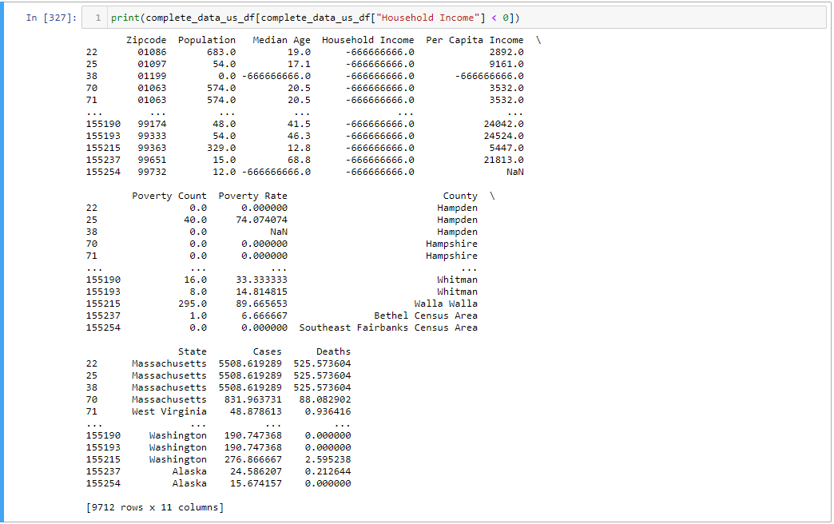
Data Exploration & Clean up
Notes:
-Dropped values that could cause errors
Went back and forth between the ny times data sourse b/c there were 2 csv files 1 historic data(daily cases per county, everyday), difficult time .agg to get accurate values
Transitioned to using the live nytimescovid .csv file that gave us current totals by state and county, without having to manipulate the data to find the totals ourselves.
Census data set was accounted for geographic zip code and the nytimes data set accounted for the different smaller geographic counties. Had to find a 3rd data source in order to merge the nytimes data with census data

Slide 6
Analysis Process & Challenges
Merge data: census and economic data in one table
Sorted States to find top five states with the most cases and bottom five states with least cases
Found counties to be same name for other states- grouped data based on county and state
Statistical analysis for both groups to test correlation for total cases v. per capita income
Reviewed population of US to examine population density v. COVID-19 and if there is a correlation
Notes:
Found counties to be same name for other states- grouped data based on county and state

Slide 7
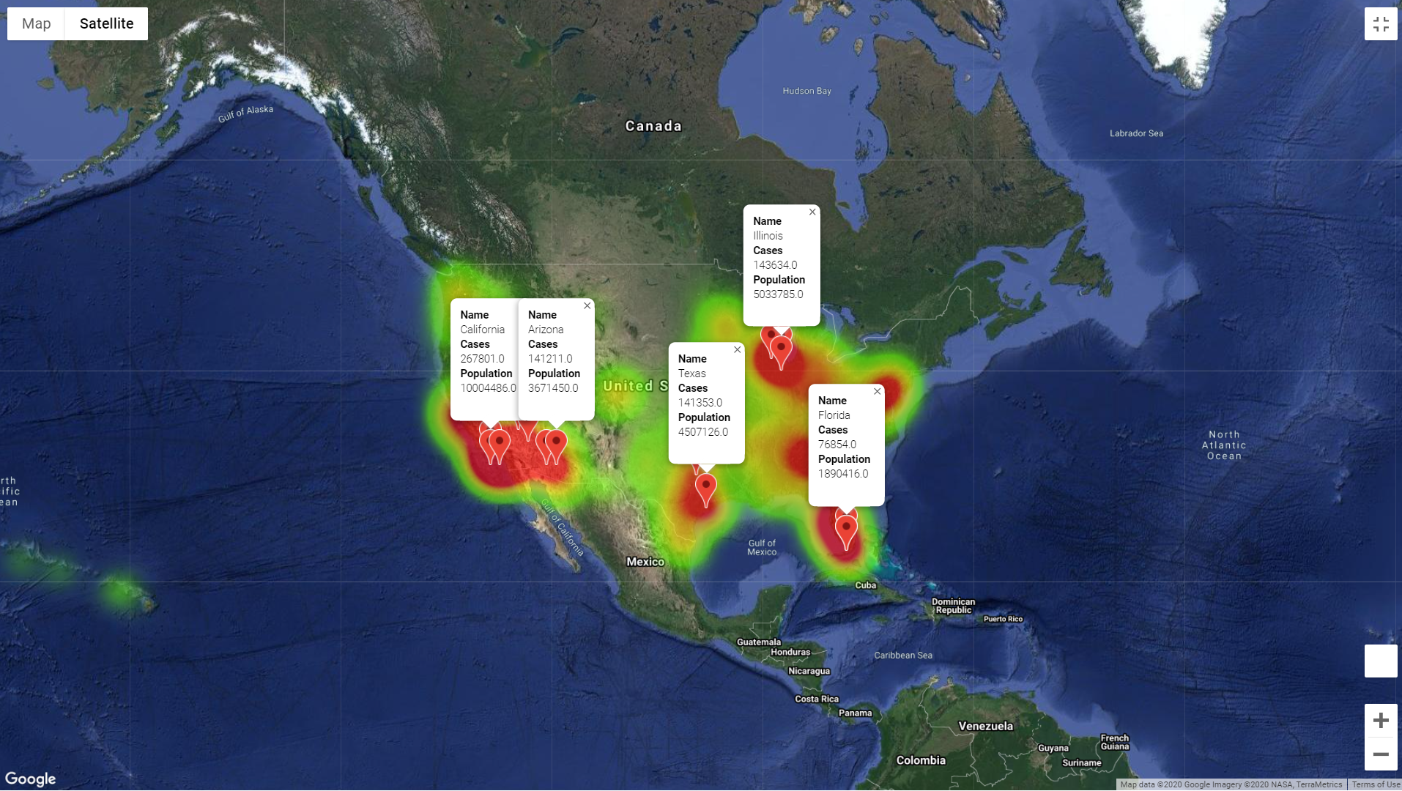

Slide 8
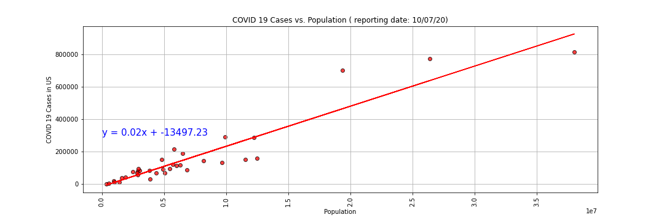
The r-value is: 0.94
There is a positive correlation between population and COVID-19 cases
Notes:
What is this graph saying?
- Per 500 people in US there is an increase of cases?

Slide 9
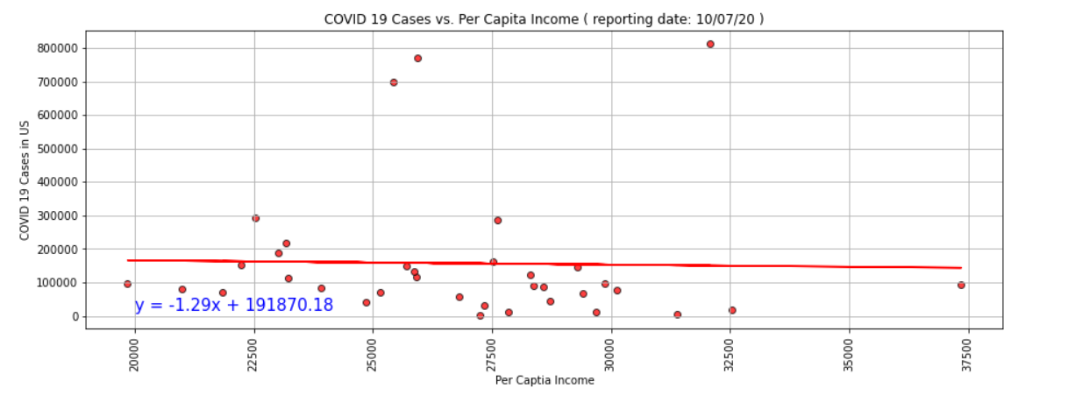
The r-value is: : -0.02
Conclusion that Per Capita Income has a weak correlation.

Slide 10
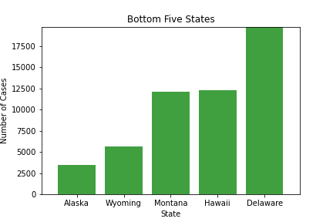
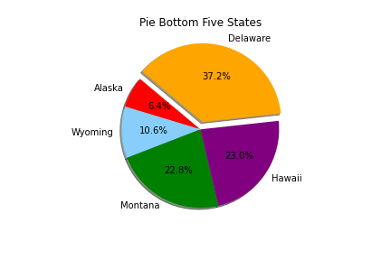
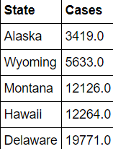
Bottom 5 States with the least COVID-19 cases
Notes:
These values are averages

Slide 11
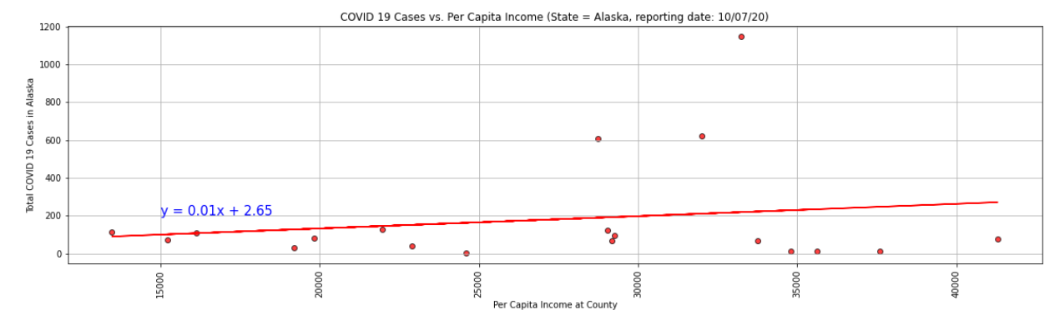
Alaska (least cases in US)
The r-value is 0.17
There is a weak correlation between Per Capita Income and COVID-19 cases in Alaska

Slide 12
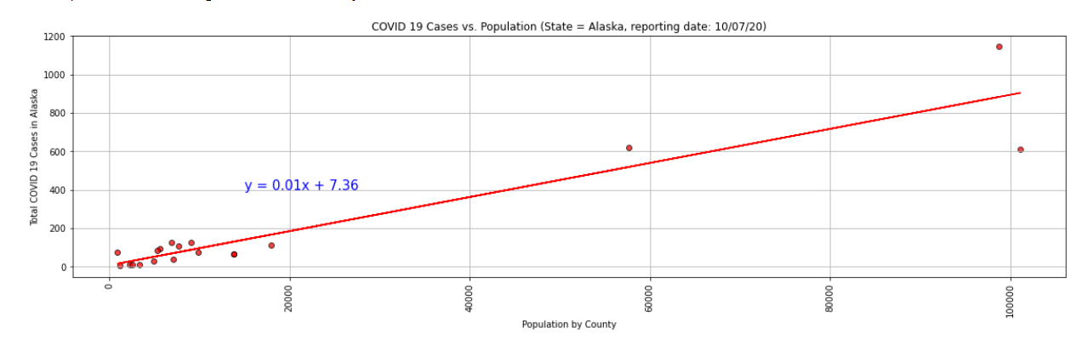
Alaska (least cases in US)
The r-value is 0.93
There is a strong correlation between population and COVID-19 cases in Alaska

Slide 13
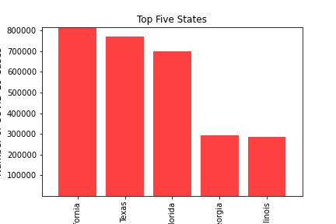
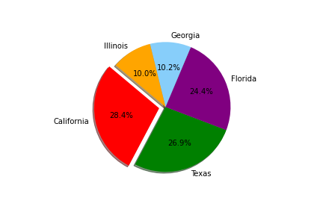
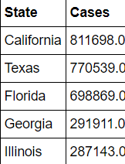
Top 5 States with the most COVID-19 Cases

Slide 14
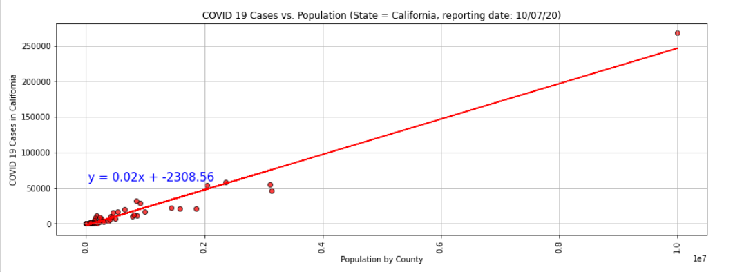
California
The r-value is: 0.97
There is a strong correlation between population and COVID-19 cases in California

Slide 15
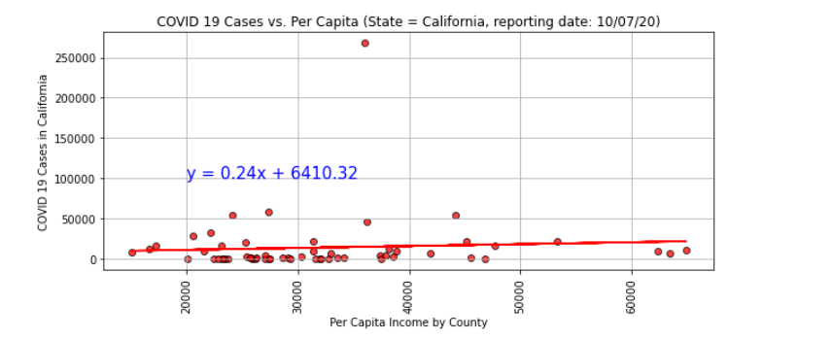
California
The r-value is: 0.07
There is a weak correlation between Per Capita Income and COVID-19 cases in California

Slide 16
What does this mean?
Per Capita Income did not have as strong of a correlation to the number of Covid-19 cases as we expected
There was however a much stronger correlation between population and the number of Covid-19 cases
Based on our findings California was the top state with most cases, which they have a greatest of population

Slide 17
What to research next?
Does social distancing help with slowing the spread?
Are wearing face coverings helping with slowing the spread?
If we followed these guidelines early on would this affect the reopening of states?
Does travel restriction help with slowing the spread?

